Slide 1
Behavioral Finance Part B
Nicholas Barberis
Yale School of Management
February 2023

Slide 2
Psychology and finance
what financial phenomena might psychology help us understand better?
Psychology of decision-making
key ideas:
prospect theory
ambiguity aversion
Psychology of beliefs
key ideas:
belief in law of small numbers
conservatism
belief perseverance and confirmation bias
availability heuristic
overconfidence
the influence of feelings

Slide 3
Prospect theory
the loss aversion component of prospect theory has been linked to:
the equity premium puzzle
historical non-participation in the stock market
The equity premium puzzle
over the past century, the U.S. stock market has earned a much higher average return than T-Bills
the difference is puzzlingly high
loss aversion may help explain this
Non-participation
e.g., in 1984, only 28% of U.S. households had any exposure at all to the stock market
again, loss aversion may have played a role

Slide 4
An aside: Non-participation
there are other psychological approaches to non-participation
one of them is based on trust
in a survey of 1,943 Dutch households, less trusting households invested less in the stock market
Guiso, Sapienza, Zingales (2008)
trust is measured through survey questions:
“Generally speaking, would you say that most people can be trusted or that you have to be careful in dealing with people?”

Slide 5
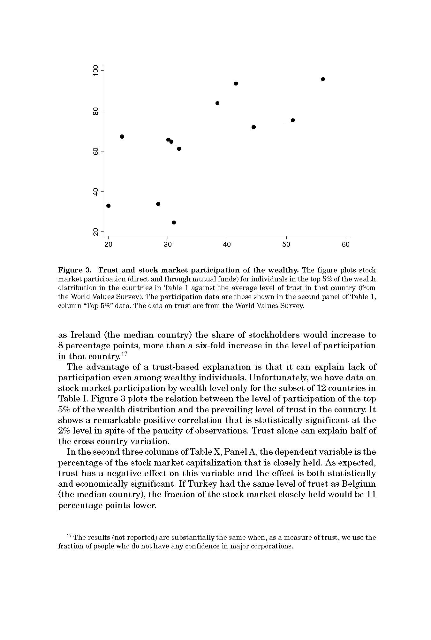
An aside: Non-participation
trust also explains cross-country differences in stock market participation rates
U.S.
Sweden
U.K.
Netherlands
Denmark
France
Switzerland
Itary
Stock market participation to 5%
Germany
Greece
Austria
Spain
trust

Slide 6
An aside: Non-participation
another psychological approach to non-participation is based on experience effects
when making a decision, we should look at all past data and draw the appropriate inferences
mounting evidence suggests that people overweight data that they have personally experienced
e.g. the stock market return someone has personally experienced during their lifetime affects
the likelihood that they will participate in the stock market
and how much they invest, conditional on participation
Malmendier and Nagel (2011)

Slide 7
Prospect theory
the “probability weighting” component of prospect theory also makes interesting predictions
positively-skewed, i.e., “lottery-like” assets will be overpriced and earn a low average return
negatively-skewed assets will be underpriced and earn a high average return
Barberis and Huang (2008)
these ideas have many applications

Slide 8
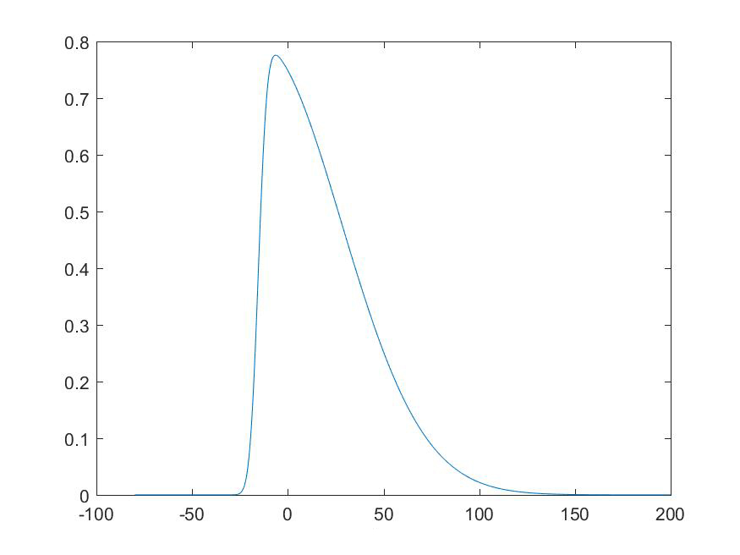
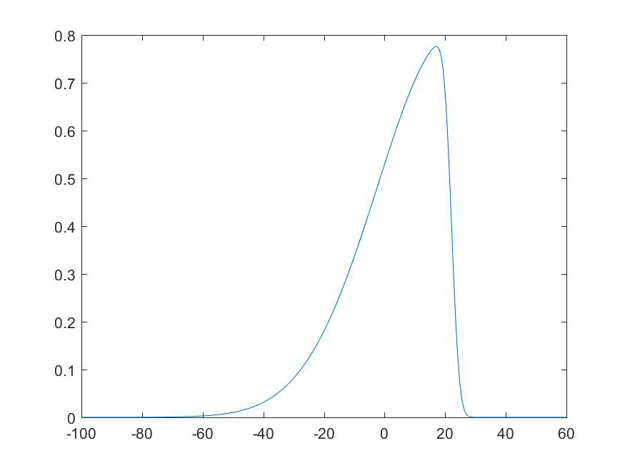
Prospect theory
Positive skewness
Negative skewness
probability
return
probability
return

Slide 9
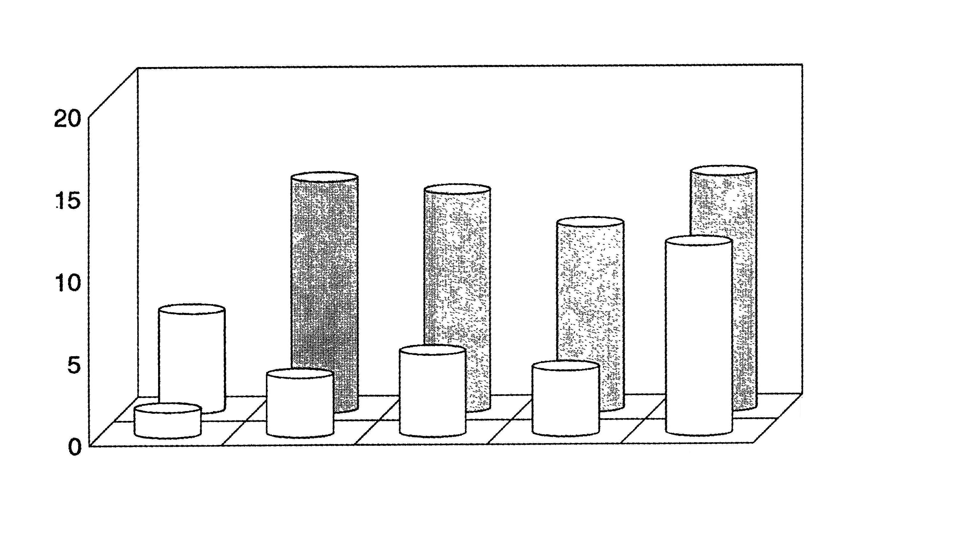
Prospect theory
Applications
the average return on IPO stocks in the 5 years after issue is surprisingly low
but note that the 5 year post-issue return distribution is also highly positively skewed
Annual percentage return
Non-issuers
First Year
Second Year
Third Year
Fourth Year
Fifth Year
IPOs

Slide 10
Prospect theory
Applications, ctd.
the appeal of positively-skewed assets may also explain:
the low average returns of distressed stocks, stocks traded off-exchange, stocks with high volatility, and out-of-the-money options on stocks
the popularity of entrepreneurship
the underpricing of negatively-skewed assets may explain:
the high average return on the aggregate stock market
Forecasting stock returns
can we directly test the initial prediction?
that more positively skewed stocks will have lower average returns
Boyer, Mitton, Vorkink (2010) confirm the prediction using a regression model to predict skewness
use past idiosyncratic volatility and skewness, past return, and past turnover as predictor variables

Slide 11
Ambiguity aversion
ambiguity aversion predicts a high equity premium
and similarly, non-participation in the stock market
both of these predictions are consistent with the historical U.S. experience
it also predicts that stocks that are more “uncertain” should earn a higher average return
unfortunately, there is little evidence so far to support this prediction
e.g., stocks that analysts disagree about more have lower average returns

Slide 12
Belief in a law of small numbers
a belief in a law of small numbers leads people to over-extrapolate past trends
in the context of investing
if an asset, asset class, or fund has recently had above-average returns, some investors overestimate its future returns
if an asset, asset class, or fund has recently had below-average returns, some investors underestimate its future returns
over-extrapolation is one of the most important ideas in behavioral finance, with many applications
stock market fluctuations
time-series predictability in the stock market
momentum and reversals in many asset classes
the formation and collapse of asset bubbles

Slide 13
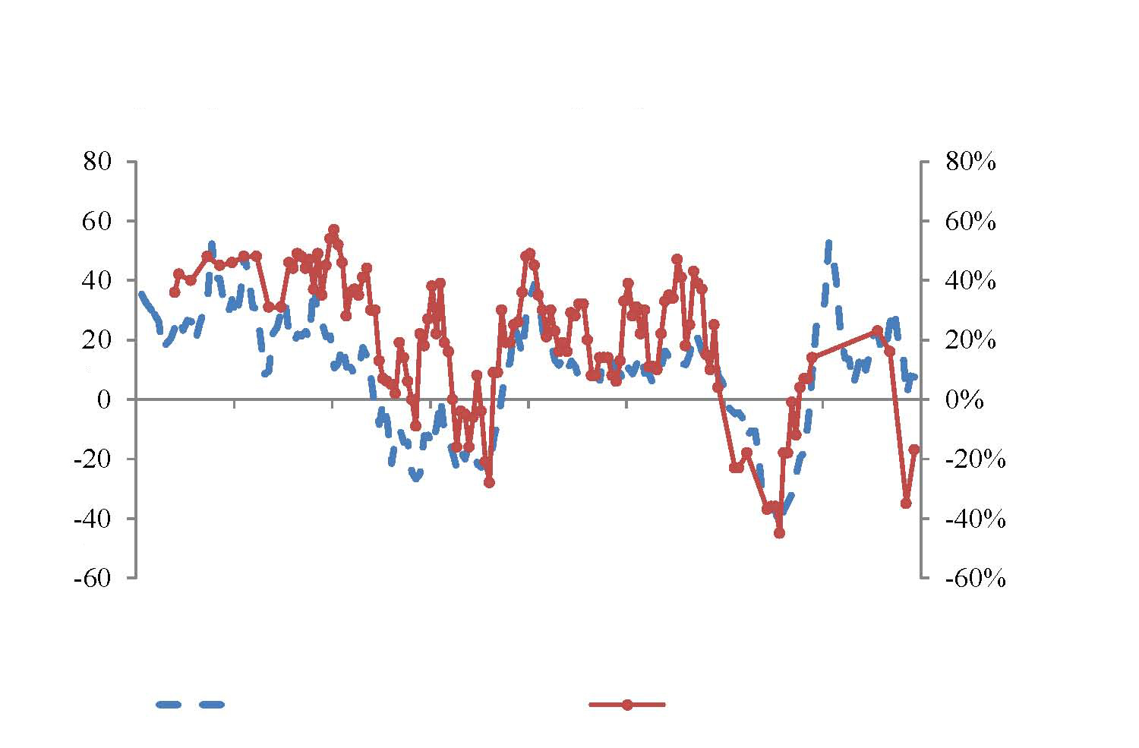
Over-extrapolation
survey data, collected from both individuals and institutions, provide evidence for over-extrapolation
Greenwood and Shleifer (2014)
after good (poor) past returns, investors expect continued good (poor) returns
but these beliefs are incorrect
The Role of Past Stock Market Returns in Explaining Survey Expectations
The solid line denotes the 12-month rolling nominal return on the CRSP VW stock index. The line marked with circles denotes the percentage of investors who are bullish in the Gallup survey.
Gallup % Bullish-% Bearish
Past Stock return
Jan-96
Jan-98
Jan-00
Jan-02
Jan-04
Jan-06
Jan-08
Jan-10
Lagged 12-month Returns
Gallup Survey Expectations

Slide 14
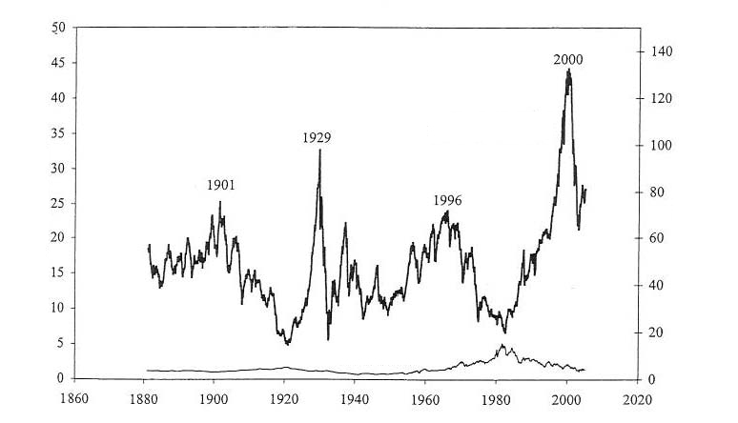
Over-extrapolation
Stock market fluctuations
the P/E ratio of the U.S. stock market has fluctuated significantly over the decades
but it has proven difficult to explain these fluctuations on rational grounds
e.g., as the result of rationally-varying forecasts of future cash flows, interest rates, or risk
Price-earnings ratio
Price-earnings ratio
Interest rates
Interest rates

Slide 15
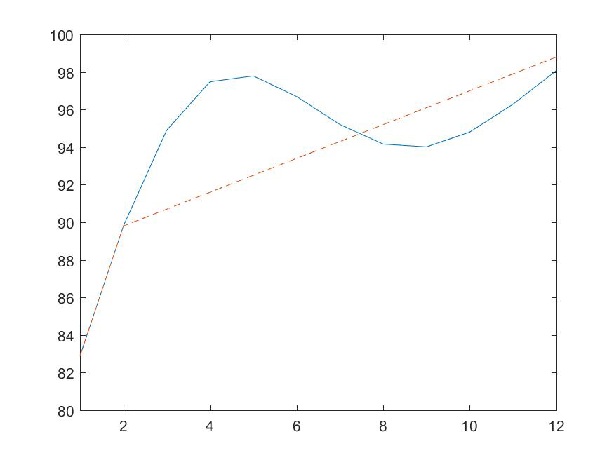
Over-extrapolation
Stock market fluctuations, ctd.
behavioral approach: models where some investors extrapolate past returns can explain stock market fluctuations
Barberis, Greenwood, Jin, Shleifer (2015, 2018)
the graph below shows the price path of a risky asset in such an economy, following good cash-flow news
price
time

Slide 16
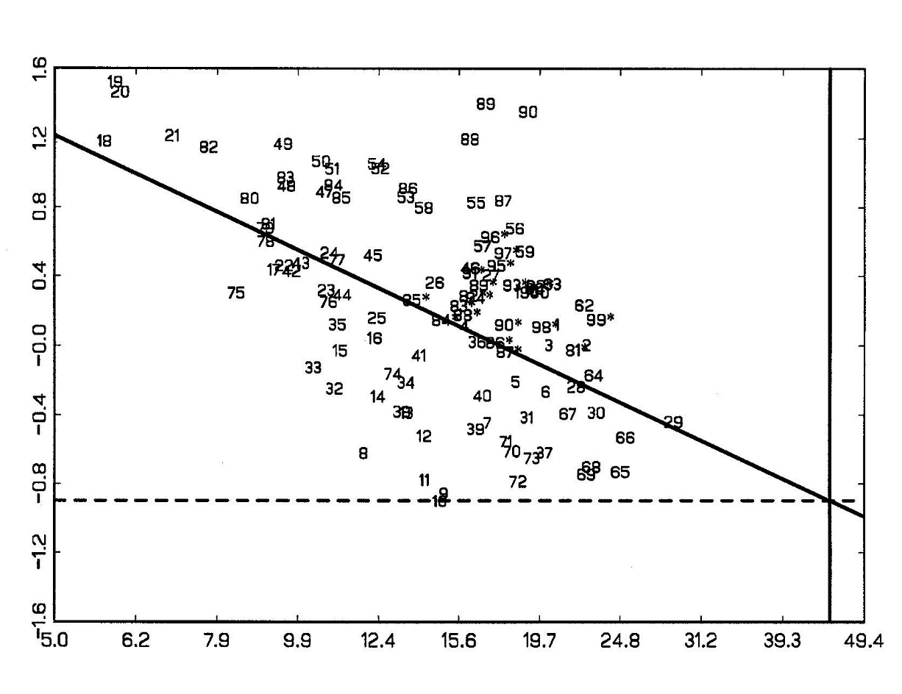
Over-extrapolation
Time-series predictability
the P/E ratio of the aggregate U.S. stock market negatively predicts the market’s subsequent return in the time series
over-extrapolation of returns offers an explanation for this pattern
10-year PRICE GROWTH vs P/10-year MA(E)
10-yr PRICE GROWTH
44,9 in 2000
P/10-year MA(E)

Slide 17
Over-extrapolation
Momentum and reversals
a stock’s 6-month past return positively predicts its subsequent return
a stock’s 3-year past return negatively predicts its subsequent return
over-extrapolation is a leading behavioral finance approach to these facts

Slide 18
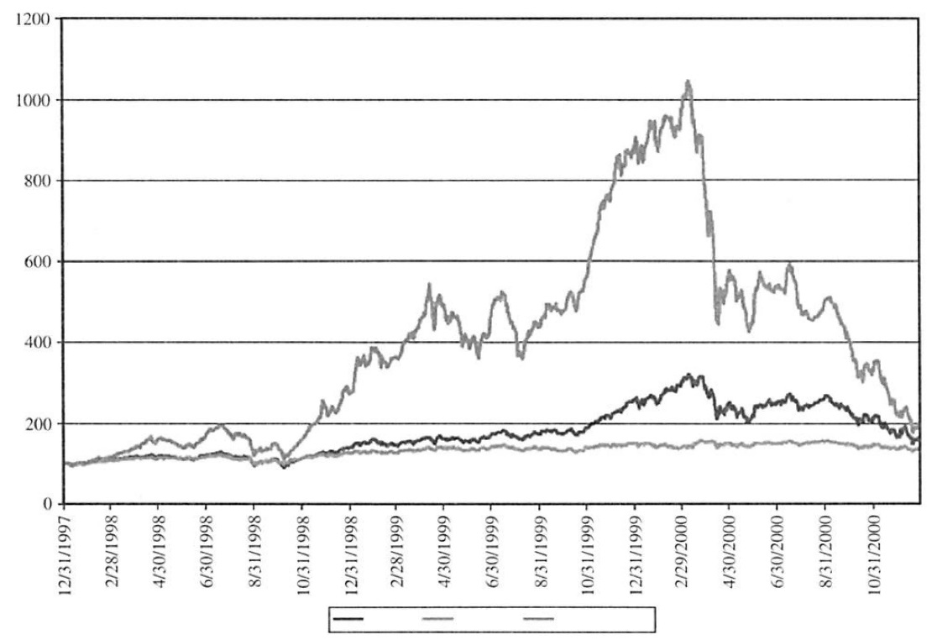
Over-extrapolation
Bubbles
episodes where:
the price of an asset rises dramatically and then collapses
and during the price rise, there is much talk of possible overvaluation and high volume
over-extrapolation is a leading behavioral finance theory of the formation and collapse of bubbles
Kindleberger (1977), Barberis et al. (2018)
Nasdaq
S&P 500
Internet index

Slide 19
Conservatism, Belief perseverance
conservatism and belief perseverance predict that investors may be slow to react to important news announcements
e.g., to earnings announcements
historically, there is indeed evidence of underreaction to earnings announcements
“post-earnings announcement drift” (Bernard and Thomas, 1989)

Slide 20
Conservatism, Belief perseverance
Post-earnings announcement drift
rank firms by the size of the surprise in their most recent earnings announcement
firms with positive (negative) surprises subsequently do well (poorly)
hard to explain from a rational finance viewpoint
Preannouncement period
SUE deciles
postannouncement period
SUE deciles
Event Time in Trading Days Relative to Earnings Announcement Day

Slide 21
Overconfidence
overconfidence means
excessive confidence in the precision of one’s forecasts
an overly rosy view of one’s abilities and prospects
it has been linked to several financial phenomena
excessive trading by some investors and, more generally, the high volume of trading in financial markets
the preference for active management
excessive M&A activity
overpricing and bubbles

Slide 22
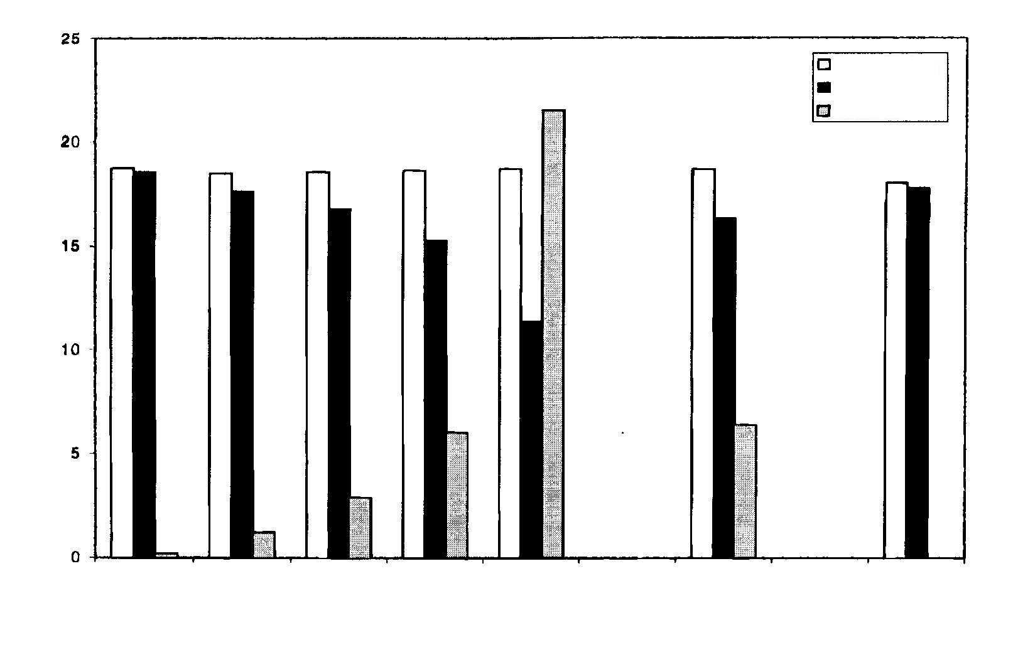
Overconfidence
Excessive trading
using data from a large discount brokerage over a six-year period, Barber and Odean (2000) find that, on average, individuals underperform a range of benchmarks
those who trade the most, do the worst
overconfidence offers a possible explanation
Gross Return
Net Return
Turnover
Percentage Annual Return/Monthly Turnover
1 (Low Turnover)
2
3
4
5 (High Turnover)
Average Individual
S&P 500
Index
Fund
Individual investors Quintiles based on Monthly Turnover

Slide 23
Overconfidence
Excessive trading, ctd.
Test 1:
Grinblatt and Keloharju (2009) obtain trading records for investors in Finland, but also a measure of each trader’s overconfidence
based on psychological and aptitude tests at age 18, before military service
find a significant link between overconfidence and intensity of trading activity
Test 2:
psychologists have found that men display slightly more overconfidence more than women, on average
predicts that men should trade more and have lower average returns
prediction is confirmed in the original dataset

Slide 24
Overconfidence
High volume of trading
it is hard to understand the high overall volume of trading without appealing to something like overconfidence
in a fully rational economy, there would be relatively little trading
people infer a negative signal from others’ willingness to trade
overconfidence offers a way out of this logjam

Slide 25
Overconfidence
The active management puzzle
the average actively-managed mutual fund underperforms index funds, after fees
the popularity of active funds is therefore a puzzle
overconfidence is one way of understanding it
other explanations?

Slide 26
Overconfidence
Excessive M&A activity
why are there so many acquisitions, when there is little evidence that they create value, on average?
on average, stock of bidder loses value over the three years after the event, relative to a control group
CEO overconfidence is one possible explanation
“Many managements were overexposed in impressionable childhood years to the story in which the imprisoned handsome prince is released from a toad’s body by a kiss from a beautiful princess. Consequently, they are certain their managerial kiss will do wonders for the profitability of Company T[arget]…We’ve observed many kisses but very few miracles. Nevertheless, many managerial princesses remain serenely confident about the future potency of their kisses – even after their corporate backyards are knee-deep in unresponsive toads.”
(Warren Buffett, Berkshire Hathaway Annual Report, 1981)

Slide 27
Overconfidence
Excessive M&A Activity, ctd.
one study identifies overconfident CEOs as those who hold on to their executive stock options longer than recommended by standard exercise models
find that:
these managers do more acquisitions
in particular, they do more “diversifying” acquisitions
market reacts more negatively to acquisition announcements from these managers
another measure of overconfidence based on press reports leads to similar results
Source: Malmendier and Tate (2008)

Slide 28
Feelings
Affective feelings
there is evidence that exogenous stimuli that affect mood can in turn affect stock prices
stimulus: soccer
if the national soccer team loses a World Cup match, the national stock market does poorly the next day (Edmans, Garcia, Norli, 2007)
stimulus: sunshine
the stock market does better on sunny days (Hirshleifer and Shumway, 2003)

Slide 29
Feelings
Cognitive feelings
if investors exhibit a “mere exposure” effect , they will disproportionately invest in:
the domestic stock market
locally headquartered stocks
own-company stock
individual investors do indeed exhibit a surprisingly large preference for these assets

Slide 30
An aside: Under-diversification
there are other psychological approaches to thinking about under-diversification
one of them is based on the idea of loyalty
for example, large allocations to own-company stock may be driven by feelings of loyalty
Cohen (2009) presents evidence consistent with this
similarly, home bias puzzle may be explained by loyalty to home country, i.e., patriotism
find that home bias is more pronounced in countries where people are more patriotic
Morse and Shive (2009)

Slide 31
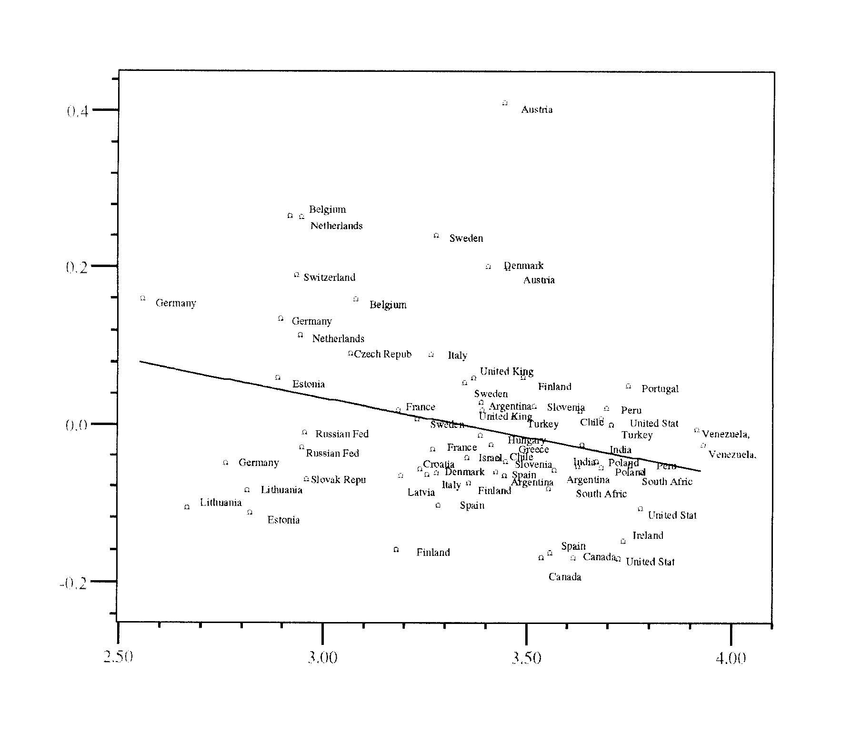
An aside: Under-diversification
Source: Morse and Shive (2009)
Foreign Equity Holdings Percentage
Patriotism Score

Slide 32
Criticisms of behavioral finance
Criticism I
the field is “undisciplined”
“it’s too easy to find psychology that fits the facts”
Response:
emphasize tests of new predictions

Slide 33
Criticisms of behavioral finance
Criticism II
“surely smart traders will quickly undo any effect irrational people have on prices”
Response:
money managers face risks when attempting to exploit a mispricing
e.g., the risk that the mispricing worsens in the short run
there are “limits to arbitrage”

Slide 34
Limits to arbitrage
Example: Twin stocks
shares that are claims to the same cash flows but trade in different locations
e.g., Royal Dutch & Shell
Royal Dutch, traded primarily in the Netherlands and the U.S., is a claim to 60% of the cash flow
Shell, traded primarily in London, is a claim to 40% of the cash flow
should find that
market value (Royal Dutch)
market value (Shell)
but don’t!
= 1.5

Slide 35
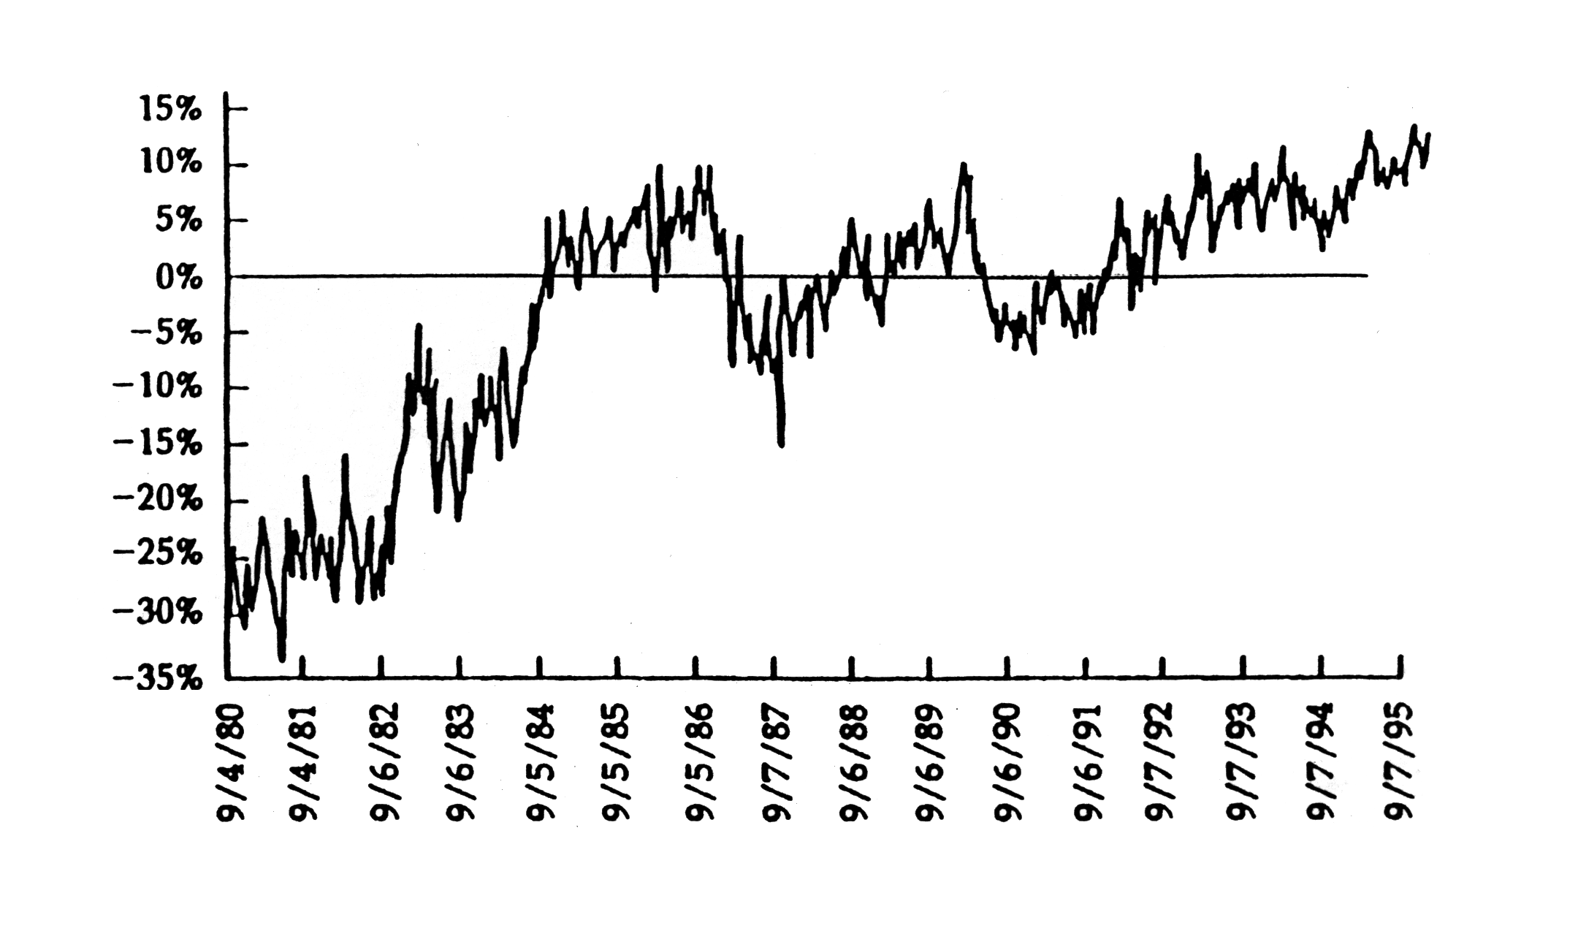
Limits to arbitrage
Royal Dutch and Shell deviations from parity
Percent deviation

Slide 36
Prescriptive behavioral finance
how can we help people overcome their biases and make better decisions?
awareness of the biases is a first step
some explicit de-biasing techniques are also effective
e.g., for overconfidence, asking “Why not?”, or giving a public explanation of one’s reasoning

Slide 37
Prescriptive behavioral finance
institutional design can be particularly effective
“Nudge” (Thaler and Sunstein, 2008)
e.g., the use of default options
two principles:
don’t restrict the range of options available to people
but construct a sensible default option
because inertia means that people are likely to choose the default option
Application: Insufficient saving
many people want to save a larger fraction of their income, but don’t manage to do so
behavioral hypothesis: self-control problems
one solution is to switch retirement plans from “opt in” to “opt out”
makes a significant difference to contribution rates

Slide 38
Summary
there is mounting evidence that behavioral finance ideas play a central role in many important financial phenomena
asset market fluctuations, performance of investment strategies, trading volume, M&A activity, bubbles...
the most important concepts are:
over-extrapolation, overconfidence, and prospect theory
Further reading:
“A Survey of Behavioral Finance” (Barberis and Thaler, 2003)
“Psychology-based Models of Asset Prices and Trading Volume” (Barberis, 2018)
“Thinking, Fast and Slow” (Kahneman, 2011)

